Slide 1
Introduction to Machine Learning
Notes:
Welcome everyone. Today we'll explore Memory Management, a fundamental concept in operating systems.

Slide 2

What is Machine Learning?
Field of AI that enables computers to learn without explicit programming
Uses algorithms to find patterns in data
Improves performance with experience
Makes predictions or decisions based on data
Instead of being explicitly programmed to perform a task, these systems are trained using large amounts of data and algorithms that give them the ability to learn how to perform the task.
Notes:
Here's our agenda. We'll cover these topics in sequence, building understanding progressively.

Slide 3
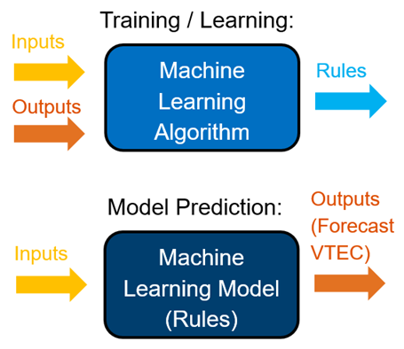
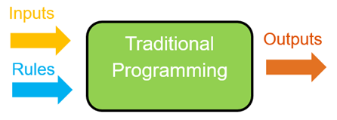
Traditional Programming vs Machine Learning
TRADITIONAL PROGRAMMING
Rules + Data → Answers
Fixed rules
Explicit instructions
Deterministic output
MACHINE LEARNING
Answers + Data → Rules
Learns patterns
Adapts to new data
Probabilistic output
(Model)
Notes:
Memory management is crucial for system performance and stability. Note the memory hierarchy - speed decreases as we move down.

Slide 4
Why Machine Learning Now?
1. Big Data Explosion
2.5 quintillion bytes of data created daily
IoT devices, social media, sensors
2. Increased Computing Power
Cloud computing
GPU acceleration
3. Better Algorithms
Deep learning breakthroughs
Improved accuracy
Notes:
This is a critical concept. Logical addresses are what programs see; physical addresses are where data actually resides.

Slide 5
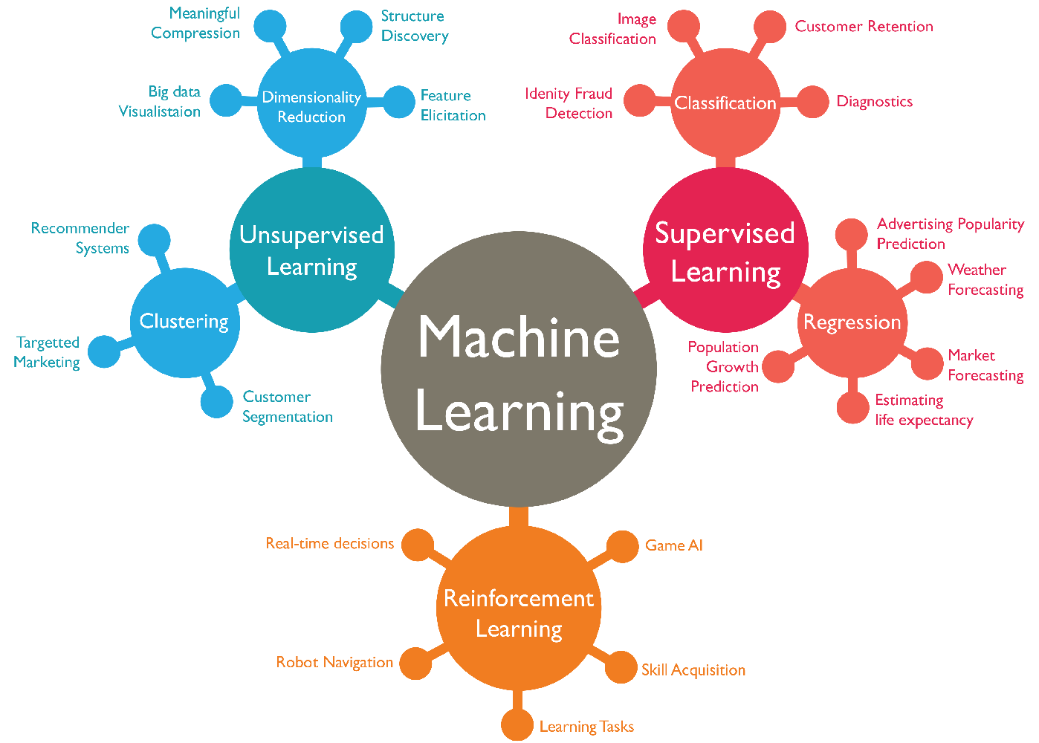
Types of Machine Learning
Notes:
The MMU handles address translation dynamically during program execution using base and limit registers.

Slide 6
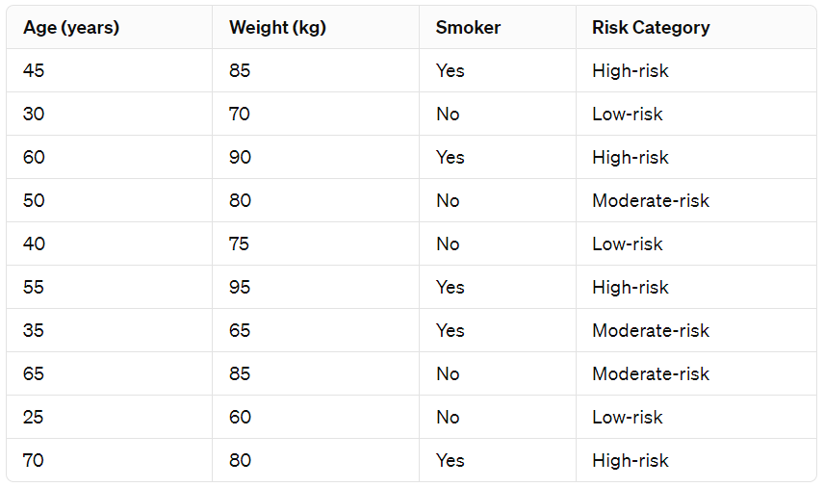
Terminology: Data
The foundation of any ML model.
It consists of the information that the algorithm will learn from.
Data can be structured (e.g., tables in a database) or unstructured (e.g., text, images).
Notes:
Let's work through this example to see how logical addresses map to physical addresses.

Slide 7
Terminology: Features
specific characteristics or attributes derived from the data
help the model make predictions
In a dataset, these are often the columns that are input into the model.
For example, features of a house might include its square footage, number of bedrooms, and age.
Notes:
Swapping allows more processes to run than physical memory can hold simultaneously.

Slide 8
Terminology: Labels
the outcomes or the target variable that the model is trying to predict.
In supervised learning, every training example includes both features and the corresponding label.
For instance, in a spam detection model, the labels would be "spam" or "not spam."
Notes:
The swap process involves moving entire processes between RAM and disk. Note the timeline.

Slide 9
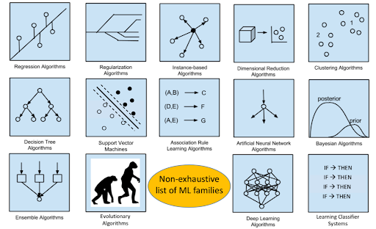
Terminology: Model
a mathematical representation of a real-world process.
It's the outcome of the training process, where the algorithm learns the relationship between features and labels.
The model can then make predictions on new, unseen data.
Notes:
Swapping has significant overhead. Modern systems use more sophisticated techniques like demand paging.

Slide 10
Types of Machine Learning
1. SUPERVISED LEARNING (what we’ve seen in the diagram earlier)
Labeled data (i.e., observations come with the corresponding output)
Inputs are called observations
Classification & Regression
Classification: classify new observations (e.g., spam vs. non-spam)
Regression: predict a value (e.g., stock price)
2. UNSUPERVISED LEARNING
Unlabeled data (i.e., we only have the observations)
Clustering & Association
Clustering: group the observations into clusters
Association: discover relationships amongst things
3. REINFORCEMENT LEARNING
Reward-based learning
Trial and error
Notes:
Contiguous allocation means each process gets a single, continuous block of memory.

Slide 11
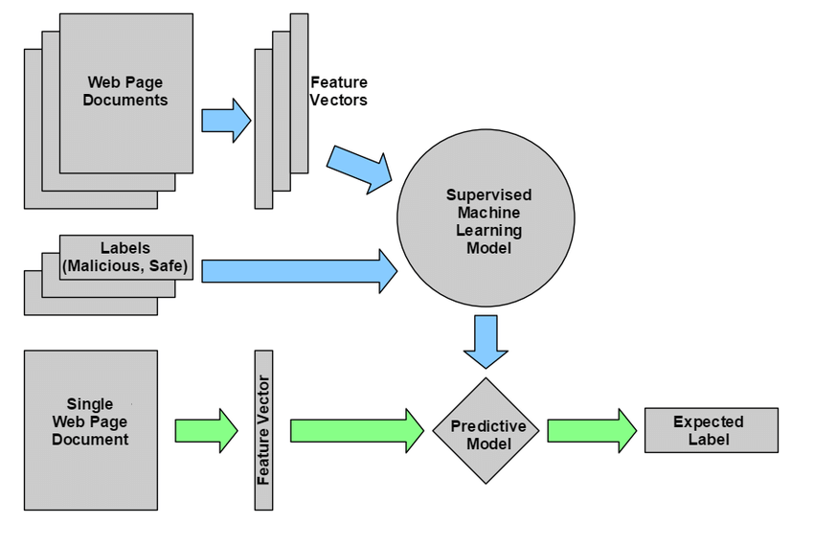
Supervised Learning
Train a model by showing it labeled data
Use the trained model to figure out the label of new data
Notes:
Fixed partitions are simple but lead to internal fragmentation. Notice the wasted space.

Slide 12
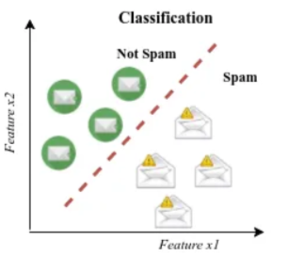
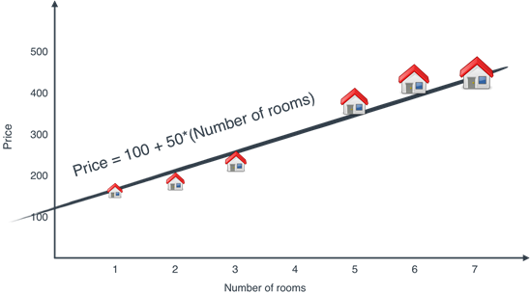
Supervised Learning
Learning from labeled data
Algorithm learns to map input to output
CLASSIFICATION:
Predict discrete categories
Examples: Spam detection, Image recognition
REGRESSION:
Predict continuous values
Examples: Price prediction, Temperature forecast
Notes:
Variable partitions eliminate internal fragmentation but create external fragmentation.

Slide 13
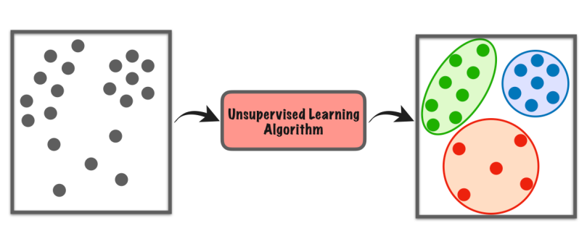
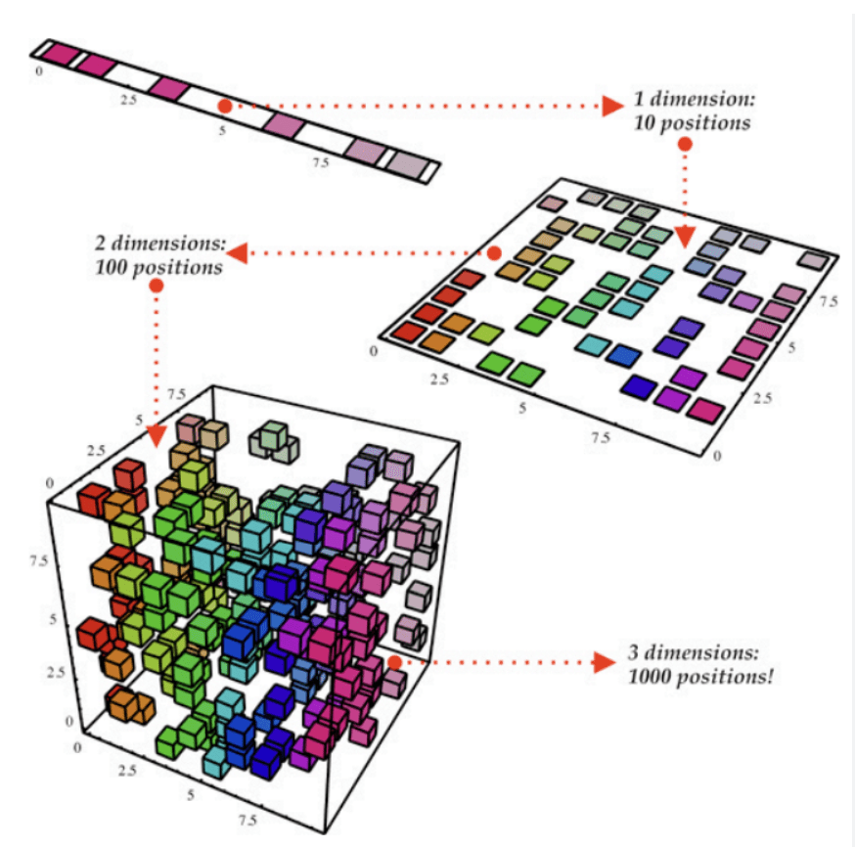
Unsupervised Learning
Learning from unlabeled data
Finding hidden patterns
CLUSTERING:
Group similar items together
Examples: Customer segmentation, Image compression
DIMENSIONALITY REDUCTION:
Reduce number of features
Examples: Feature extraction, Data visualization
ASSOCIATION:
discover relationships amongst things
Example: If a customer buys bread, they are 70% likely to also buy milk.
Notes:
Different allocation strategies have different performance characteristics. Choose based on workload.

Slide 14
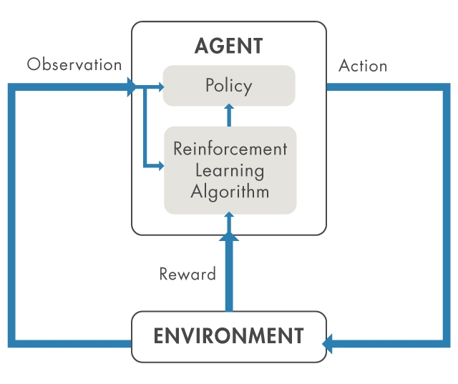
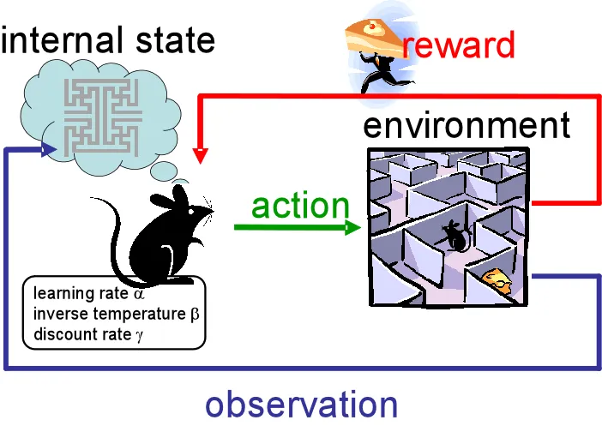
Reinforcement Learning
Agent learns through interaction
The Cycle (step by step)
Observation → The environment sends the current state to the agent (e.g., a game screen, sensor data)
Policy → The agent uses its policy to decide what action to take
Action → The agent acts on the environment
Reward → The environment evaluates the action and sends a reward signal (positive or negative)
RL Algorithm → Uses the reward to update the policy, making better decisions next time
The Goal
The agent learns to maximize cumulative reward over time by continuously refining its policy through trial and error — without being explicitly programmed on how to act.
Notes:
Understanding both types of fragmentation is key to designing efficient memory systems.

Slide 15
Common Machine Learning Algorithms
SUPERVISED:
Linear/Logistic Regression
Decision Trees & Random Forests
Support Vector Machines (SVM)
Neural Networks
UNSUPERVISED:
K-Means Clustering
Hierarchical Clustering
Principal Component Analysis (PCA)
Algorithm Selection Considerations:
Data size and dimensionality
Interpretability requirements
Computational resources
Problem complexity
Notes:
Internal fragmentation wastes space within allocated blocks. More common in fixed partitioning.

Slide 16
The Machine Learning Workflow
1. Data Collection
Gather relevant data
2. Data Preparation
Clean, transform, split data
3. Model Selection
Choose appropriate algorithm
4. Training
Feed data to algorithm
5. Evaluation
Test model performance
6. Deployment
Put model into production
Notes:
External fragmentation prevents allocation despite sufficient total free space.

Slide 17
Data Preparation
Data Cleaning
Handle missing values
Remove duplicates
Fix inconsistencies
Feature Engineering
Create relevant features
Select important features
Data Splitting
Training set (70-80%)
Testing set (20-30%)
Notes:
Compaction solves external fragmentation but requires significant CPU time.

Slide 18
Model Evaluation Metrics
CLASSIFICATION METRICS:
Accuracy = (TP+TN)/(Total)
Precision = TP/(TP+FP)
Recall = TP/(TP+FN)
F1 Score = 2*(Precision*Recall)/(Precision+Recall)
REGRESSION METRICS:
Mean Absolute Error (MAE)
Mean Squared Error (MSE)
R-squared (R²)
Notes:
These metrics help evaluate memory management effectiveness.

Slide 19
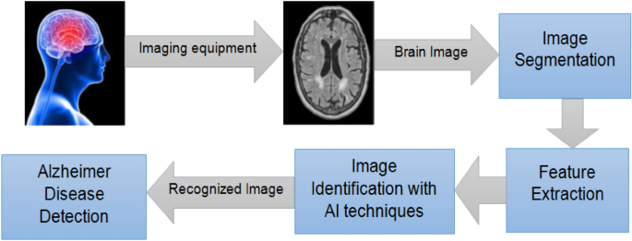
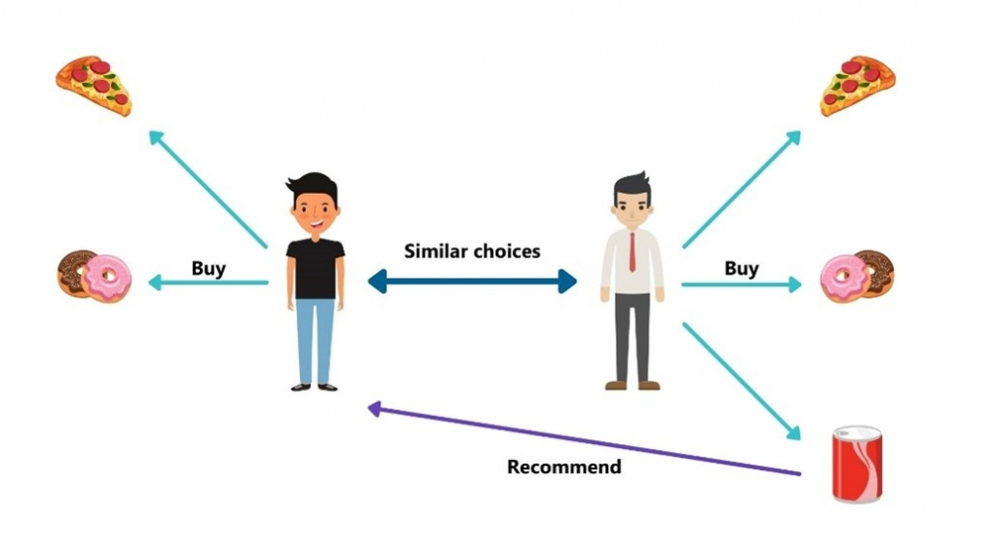
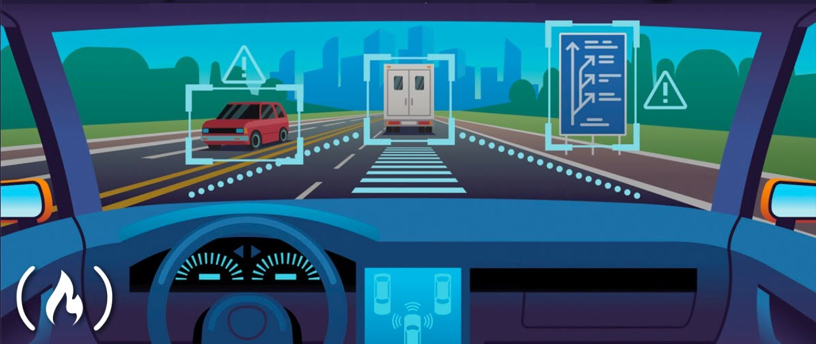
Real-World Applications
Healthcare
Disease diagnosis
Drug discovery
Finance
Fraud detection
Algorithmic trading
E-commerce
Recommendation systems
Customer churn prediction
Transportation
Route optimization
Autonomous vehicles
Notes:
Compare the trade-offs between different techniques.

Slide 20
Challenges and Limitations
Data Quality and Quantity
Need large amounts of quality data
Bias in training data
Interpretability
Black box models
Difficulty explaining decisions
Overfitting/Underfitting
Model too complex or too simple
Computational Resources
Training time and costs
Notes:
Remember these key points. Modern systems build on these fundamental concepts.

Slide 21
Summary
Machine Learning enables computers to learn from data
Three main types: Supervised, Unsupervised, Reinforcement
Follows a systematic workflow from data to deployment
Wide range of real-world applications
Growing field with immense potential
QUESTIONS?
Thank you for your attention!

